Slide 1
Exploring Medicare Hospital Spending and Quality in the Upper Midwest
CIS 671 Final Project
Yu-Ting Liu

Slide 2
Motivation and Tasks
User: insurers/healthcare consultants
High-spend, high-inpatient volume counties
Hospital stars vs market spend
Top DRGs by inpatient volume
Michigan vs neighbors’ spending

Slide 3
Data Sources
CMS (Centers for Medicare & Medicaid Services )
Medicare Geographic Variation Public Use (2023)
Hospital General Information (2025)
Medicare Inpatient Hospitals by Provider and Service (2023)
US Census county shape (2023)

Slide 4
Data Processing and Derived Measures
Region: MI, OH, IN, IL, WI
Tools: Python, GeoPandas, Observable
Link hospitals to counties via FIPS
County metrics: bed-weighted stars, z_spend
DRG metrics: top-5, HHI, payments, Med/Surg mix
County ranking: beds_sum and discharges_sum

Slide 5
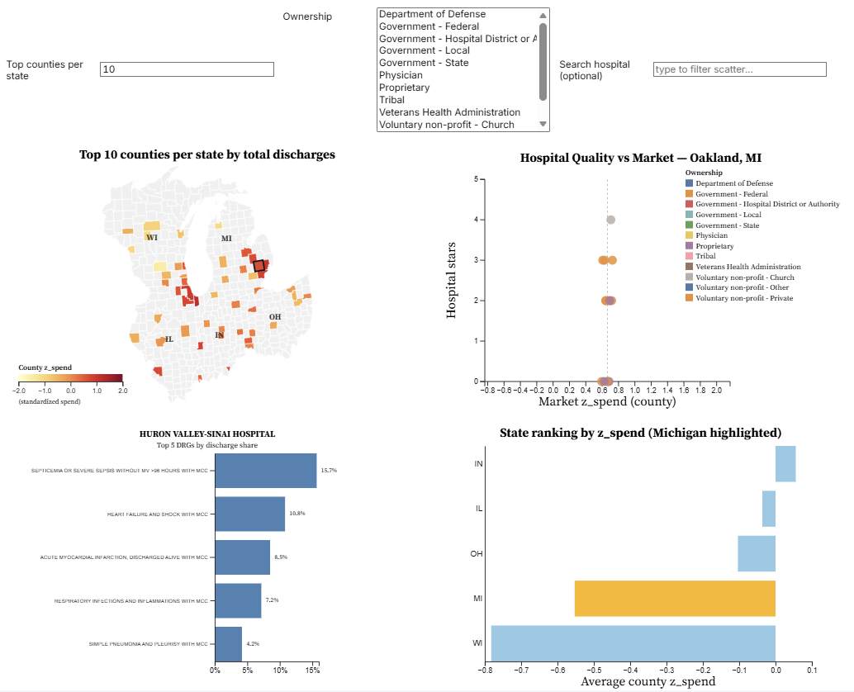
Interactive Dashboard Layout

Slide 6
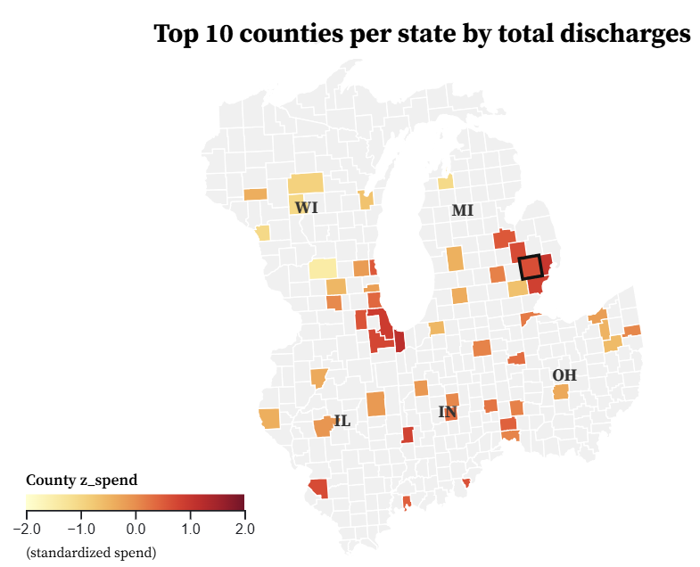
Map of Top Counties per State by Discharges

Slide 7
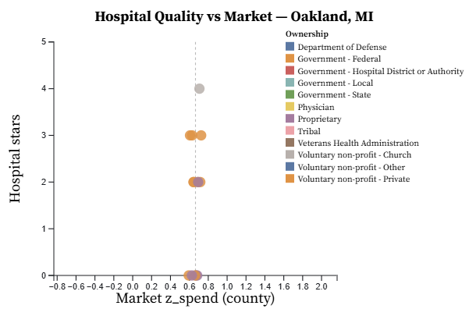
Hospital Quality versus Market Spending

Slide 8
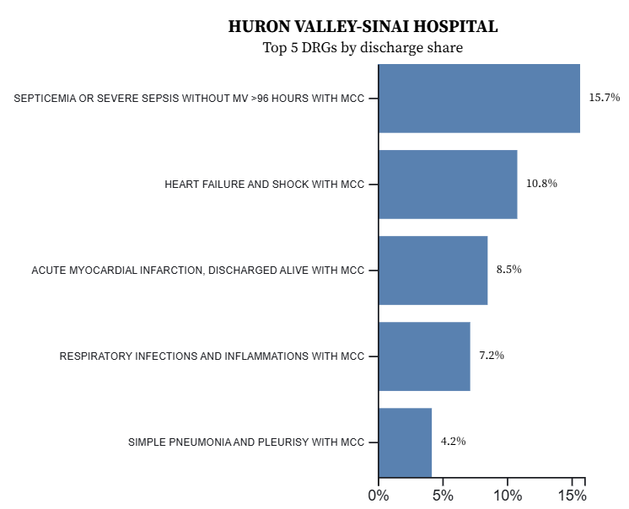
Hospital Service Mix: Top 5 DRGs

Slide 9
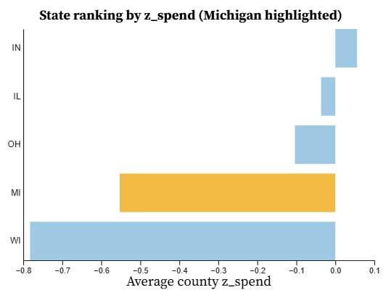
State Level Benchmarking

Slide 10
Insights from the Dashboard
High-spend, high-discharge counties cluster around major metros.
Some markets: high spending, mostly low-star hospitals.
Inpatient volume concentrates in a few high-impact DRGs.
Michigan’s average spending sits mid-range among five states.

Slide 11
Limitations and Future Extensions
County-level spend ≠ hospital efficiency
Star ratings are a limited quality proxy
Only one year, Medicare-only data
Add readmission, mortality, and post-acute metrics
Add diagnosis filters, hospital comparisons

Slide 12
Thank you!

